Slide 1

Spend Transaction Processing
Group 4 Proposal

Slide 2
Content
Use Cases for Architectural Significant Requirements
Solution View
Quality Attributes
Sequence Diagram
Proposed Budgets (Production)

Slide 3
Use Cases
File Processing, Apply Exclusions & Benefits
Upload Transaction Files (file transfer or API)
Convert Currency
Apply exclusions under a card program
Convert transaction details to benefits
Notify user of benefits
View all transactions
Campaigns Management, Notify Users
Create Promotional Campaigns
Select Customers & Corresponding Transactions
Notify user of benefits (email/ SMS)

Slide 4
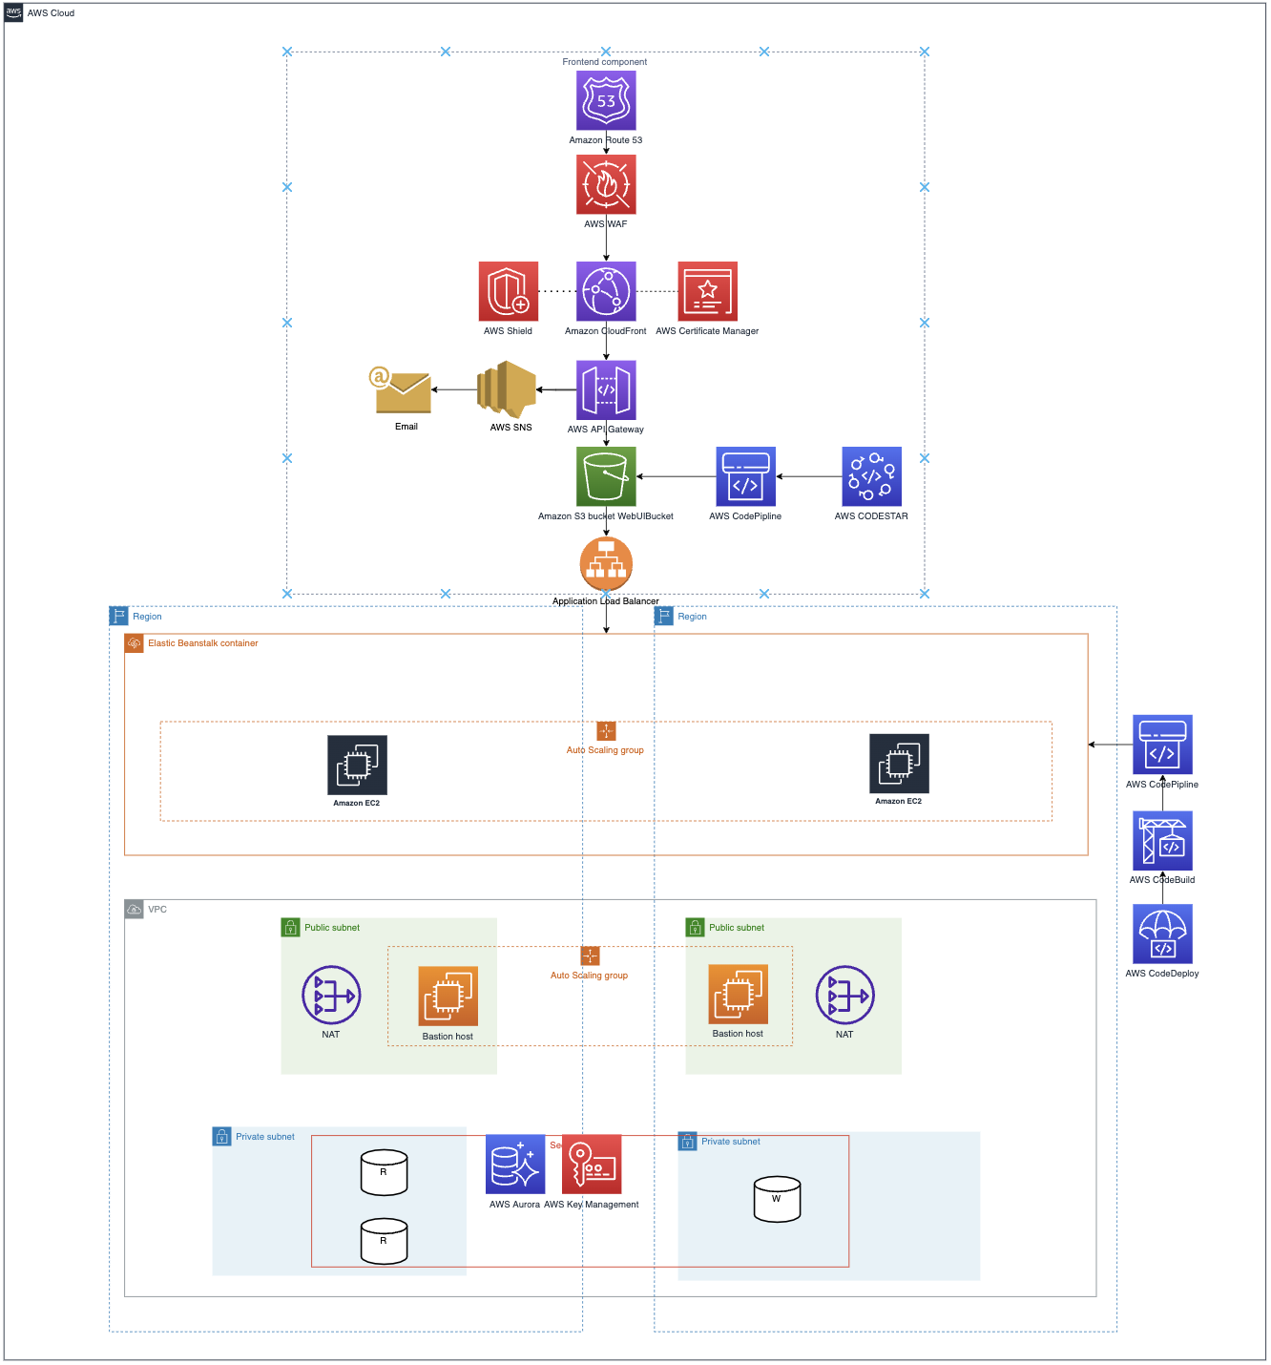



SOLUTION VIEW
Monitoring:
Costing:
Frontend Components
Server Components
Database Components
Notes:
AWS CloudWatch Alarms to act as heartbeat
AWS Cost Explorer – See patterns in AWS spending over time, project future costs, identify areas that need further inquiry, observe Reserved Instance utilization, observe Reserved Instance coverage, and receive Reserved Instance recommendations.
Spend most of the time explaining your technical solution. Justify your decisions as much as you can. Your objective is to solicit as many inputs from the sponsors as possible to finalize your design for implementation.
Performance:
Load Balancers
Scalability:
AWS Ec2 auto-scaling
Aurora
Availability:
Active-Active || Active-Passive
2 AZ
Maintanability:
CodeStar, CodePipeline, CodeBuild, CodeDeploy

Slide 5
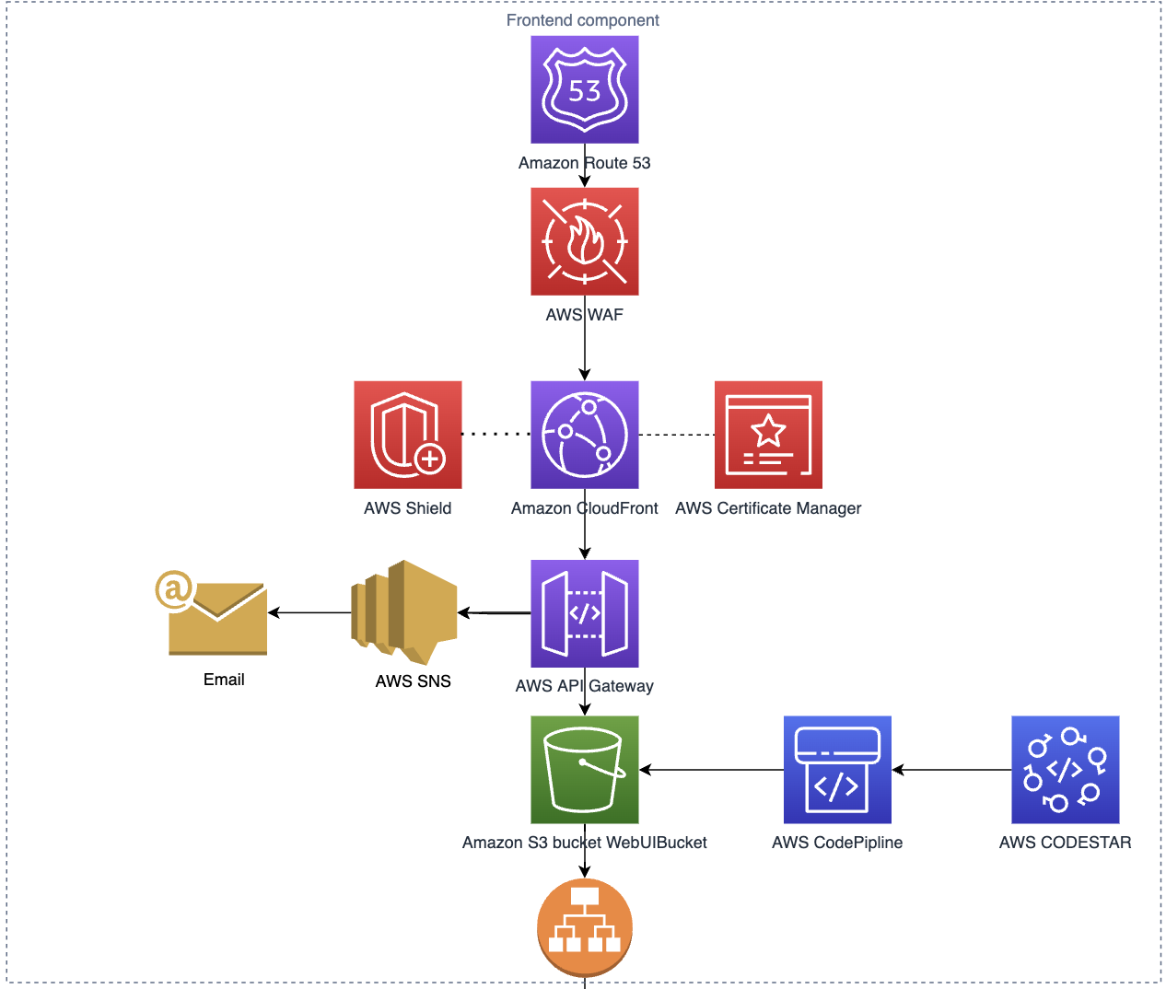
Frontend component
Static Web Pages are hosted on AWS S3 that scales at demand
AWS API Gateway: Manage RESTful API to expose HTTP endpoints & Notify Customer
AWS SNS for Email Notifications
Notes:
AWS S3:

Slide 6
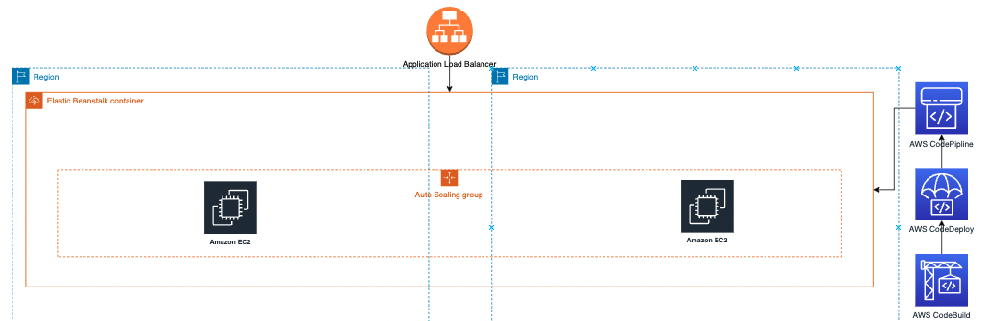
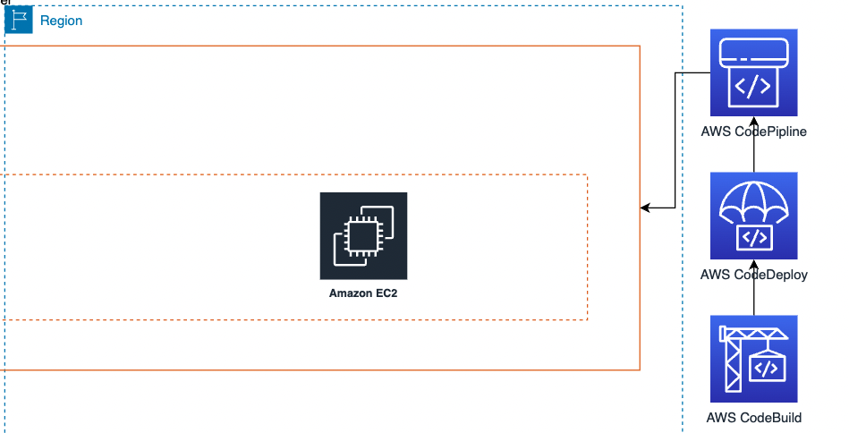
Server component
EBS Deployed at regions:
ap-northeast-2 (Seoul) ap-southeast-1 (Singapore)
AWS CodePipeline to automate release pipelines
AWS AWSDeploy: automates software deployment
AWS CodeBuild to runs builds in preconfigured build
Notes:
We picked Elastic Bean stalk over

Slide 7
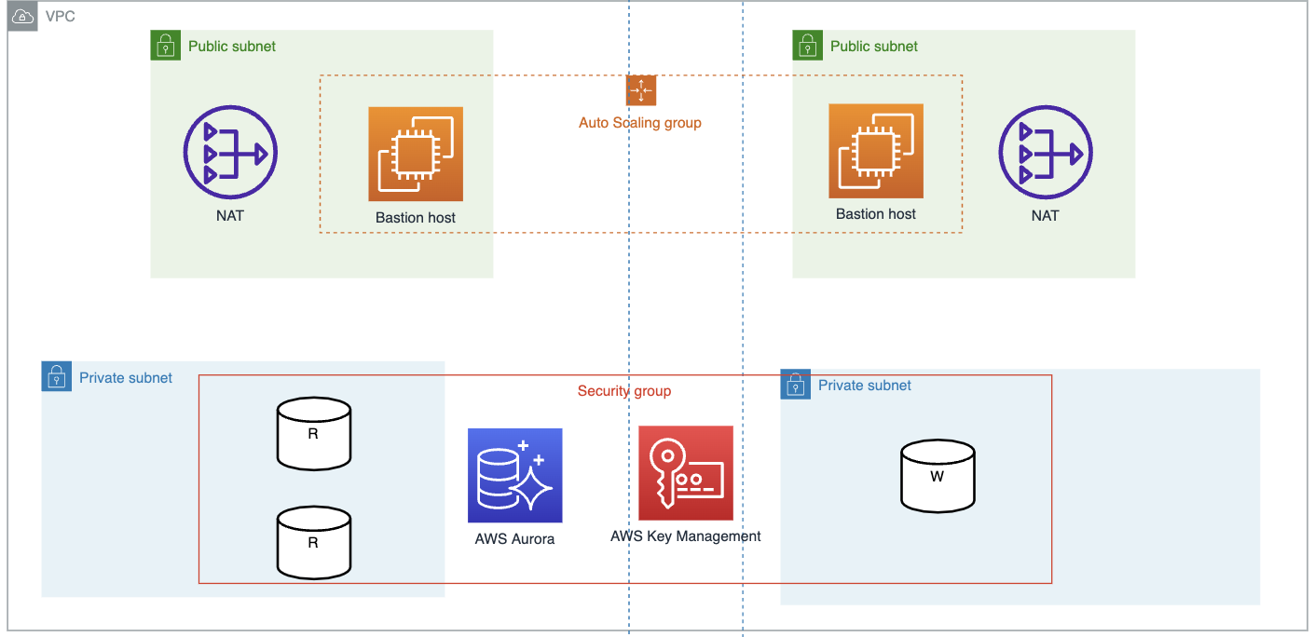
Database component
Bastion host in an Auto Scaling Group to allow access to Aurora DB Cluster in private Subnets
AWS Aurora replicas synchronously replicated across AZs AWS Key Management Service to enable encryption at rest for Aurora DB Clusters
Notes:
Public Subnet
Managed network address translation (NAT) gateways to allow outbound internet access for resources in the private subnets.*
A Linux bastion host in an Auto Scaling group to allow inbound Secure Shell (SSH) access to Amazon Elastic Compute Cloud (Amazon EC2) instances in the private subnets.*
bastion host access with TCPForwarding capabilities to run test.
AWS Key Management Service (AWS KMS). The Quick Star tuses the key to enable encryption at rest for the Aurora DB cluster.
Private subnets: an Aurora DB cluster that includes two DB readers and one DB writer.

Slide 8
Quality Attributes

Slide 9
Performance
Load balancers will equally distribute load to different servers available
Ensure that there none of the servers will be overloaded, which can cause a reduction in performance and hence delays
Notes:
Use load balancers, which will equally distribute the load to the different servers available. This will ensure that there will not be a single server that is overloaded, which can cause a reduction in performance and hence delays

Slide 10
Scalability
AWS EC2 auto-scaling
EC2 will detect a surge in traffic and auto scale up by adding EC2 instances. After traffic reduces, it will also auto scale down
Aurora can scale up horizontally automatically to handle a much greater number of requests simultaneously. It will scale down subsequently on minimum usage
Notes:
AWS EC2 auto-scaling can be implemented, whereby the EC2 will detect a surge in traffic and auto scale up by adding more EC2 instances. After the traffic reduces, it will also auto scale down accordingly
Aurora can be configured to scale up horizontally automatically to handle a much greater number of requests simultaneously. It will then scale down subsequently when there is minimum usage

Slide 11
Availability
Use of multiple servers (active-active or active-passive) and load balancer, which will detect that a request to a particular server is failing and handle the fault by routing requests to a secondary server
Deployments are distributed across 2 availability zones
Notes:
Use of multiple servers (active-active or active-passive) and load balancer, which will detect that a request to a particular server is failing and will handle the fault by routing the request to a secondary server.
The deployments are distributed across at least 2 availability zones

Slide 12
Maintanability
Utilise AWS Codestar, AWS CodePipeline, AWS CodeBuild and AWS CodeDeploy for continuous deployments, resulting in little to no downtime during updates
Health checks are conducted using AWS ElasticBeanstalk
Pipeline will identify errors detected in newly deployed updates and they will not be pushed to production
Notes:
Achieved using AWS CodePipeline, AWS CodeBuild and AWS CodeDeploy for continuous deployments, resulting in little to no downtime during updates. Health checks are conducted using AWS ElasticBeanstalk. If errors are detected in the newly deployed update, the pipeline will identify these errors and the new update will not be pushed to production.

Slide 13
Security
Ensure passwords are hashed before storing in the database
Separate different functionalities of the application to smaller microservices with different authentication details
AWS WAF blocks web exploits such as cross site scripting, SQL injections
SSL/TLS certifications allow for secure network communications
Notes:
Ensure passwords are hashed before storing in the database so hackers who gain access to the database will not see the password in plaintext
Separate different functionalities of the application to smaller microservices with different authentication details
Separate the data for each bank in the database
AWS WAF can block popular web exploits such as cross site scripting and SQL injections.
SSL/TLS certifications allow for secure network communications over the internet as well as on private networks.

Slide 14
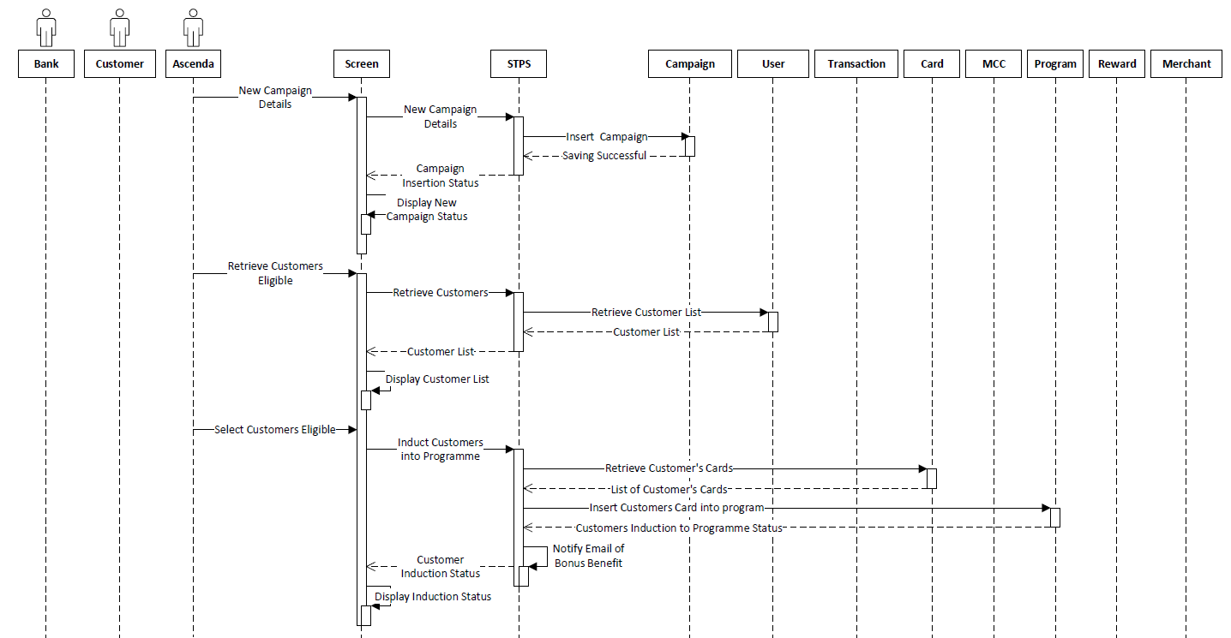
Notes:
In this page, users will do 3 things, in this case Ascenda will create new campaign details, retrieve the customers eligible and selects customer eligible. Behind the screens, STPS as the control will retrieve and insert the input into the relevant classes which ultimately store these information. Most of the calls here will be a synchronous call requiring acknowledgement. Unfortunately, we have not input the state management for this section thus far, but we do consider the fact when normal flow of things goes down, we will want to store the session into a database so to ensure the state remains available when the standby is activated.

Slide 15
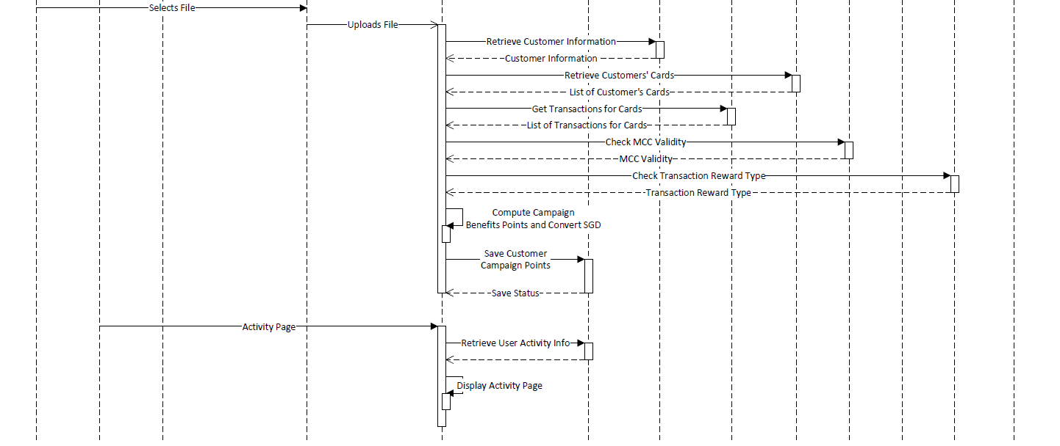
Notes:
For this page, this is where the most work is being done, this is where many records will be input requiring the scaling up of instances. That will be detected when STPS receives the upload file and will call the functions to process these tasks. Again, we will consider putting the state management to ensure the main flow will continue when it is determined that there is a disruption of service.
Customers can also retrieve the information and display it onto the activity page of their devices. The reason why information is in the campaign’s page will be that the data does not have to go many rounds of processing before being output. We had considered denormalizing some of the attributes in the database so that the speed of retrieval is faster, but the implication will be maintaining the consistency of the data. So there is where the trade offs are.

Slide 16
Budget
Service | Description | Cost
AWS EC2 T3.micro with VPC and ALB | EC2 for 1 AZ in 2 different regions | ~ 128.41 USD/month
AWS Aurora MySQL | db.t3.medium with 20 GB database storage and backup storage | ~ 62.81 USD/month
AWS S3 | S3 Standard 20GB/month, S3 Glacier 5TB/month | ~ 18.99 USD/month
Amazon CloudFront | Global CDN to deliver website and API call at high speed with low latency | 1TB Free Tier for data transfer to internet and 10 million http/https requests
AWS Route 53 | Cloud DNS web service, 1 hosted zone | ~ 10.50 USD/month
AWS Web Application Firewall (WAF) | Number of Web Access Control Lists (Web ACLs) utilized (1 per month) | ~ 5 USD/ month

Slide 17
Budget
Service | Description | Cost
AWS API Gateway | 30 million API call per month, including free tier | ~ 20 USD/month
AWS Key Management | Securely Generate and Manage AWS Encryption Keys | ~ 7 USD/ month
AWS SNS | Notification service with estimated 30 million request/month | ~ 14.50 USD/month
AWS CodeBuild | Estimated 12 builds per month Estimated 10mins build duration | ~ 2.40 USD/month
AWS CodeDeploy | Number of on-premise instances (4), Number of deployments (4 per month) | ~ 0.32 USD/ month

Slide 18
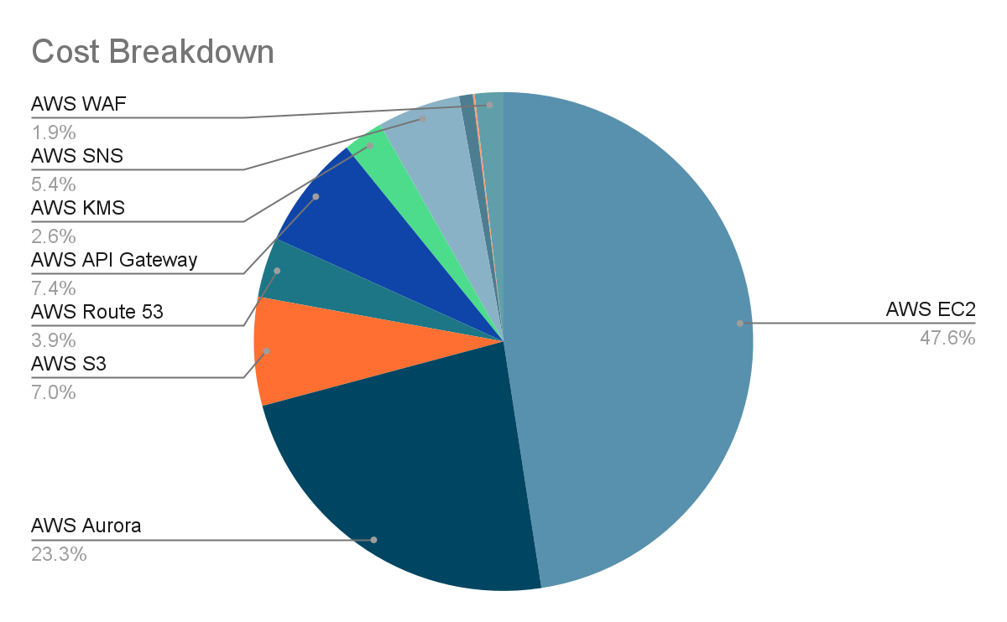
Budget
Total Cost: ~ 268.92 USD/ month

Slide 19
Thank you
Group 4

Slide 20
Instructions – Proposal Presentation
Assuming you are the architect, and you are proposing your architecture design of the solution. Your audience includes the management, development, and operation teams. You understand that this presentation is meant to solicit inputs from the sponsor and your final solution can still differ.
Keep your presentation to 10 minutes including Q&A.
Explain your business need. Keep this less than 2 mins.
Spend most of the time explaining your technical solution. Justify your decisions as much as you can. Your objective is to solicit as many inputs from the sponsors as possible to finalize your design for implementation.
Please submit your presentation slides via GitHub together with your proposal document. Create a presentation folder in your GitHub project repository, name your presentation deliverable document as Project-Presentation-<GitHub-Team-Name> and place your presentation deliverable in it.
Late submission or failure to comply with the instructions will be penalized.
Presentation slots will be announced separately.
Grading Criteria - Proposal Presentation
Timely and complete submission with conformance to the instructions.
The extent to the quality of presentation including clear descriptions, explanations, and justifications.

